Slide 1


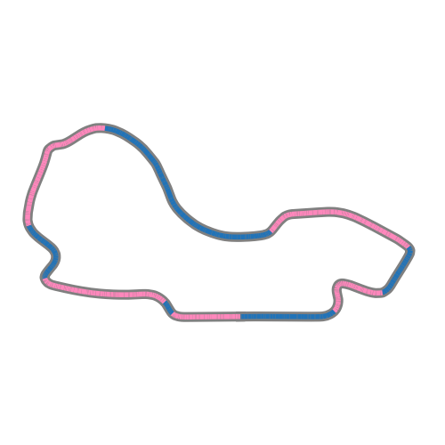
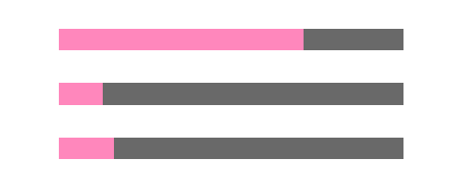
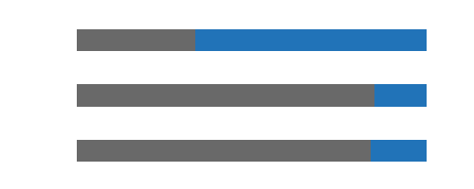
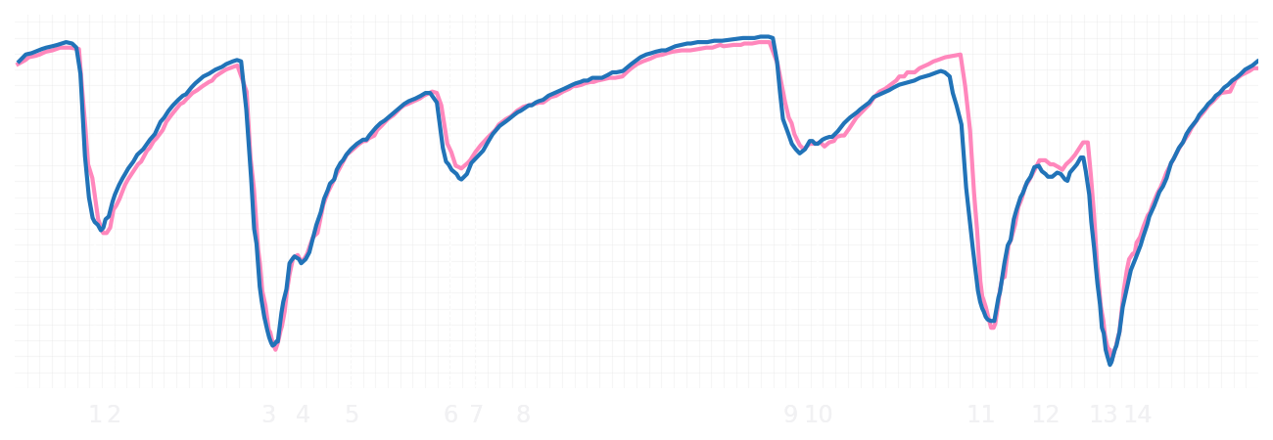
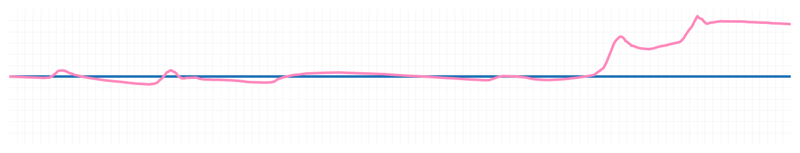
Australian GP Qualifying Q2
Pierre Gasly
Driver
Jack Doohan
Driver
Lap Time
01:16.112
01:16.863
Lap Time
Sector 1
26.400
Speed Trap 1
287 kp/h
Speed Trap 1
288 kp/h
Sector 1
26.270
Sector 2
17.152
Speed Trap 2
325 kp/h
Gap
-0.751
Gap
0.751
Speed Trap 2
328 kp/h
Sector 2
17.177
Sector 3
32.560
Speed Final Line
307 kp/h
Corner Advantage
6/15
Corner Advantage
9/15
Speed Final Line
310 kp/h
Sector 3
33.416
FULL THROTTLE
71%
66%
FULL THROTTLE
HEAVY BREAKING
13%
15%
HEAVY BREAKING
%LAP TIME
CORNERING
16%
19%
CORNERING
%LAP TIME
SPEED
SPEED
DELTA TIME
DELTA TIME

Slide 2

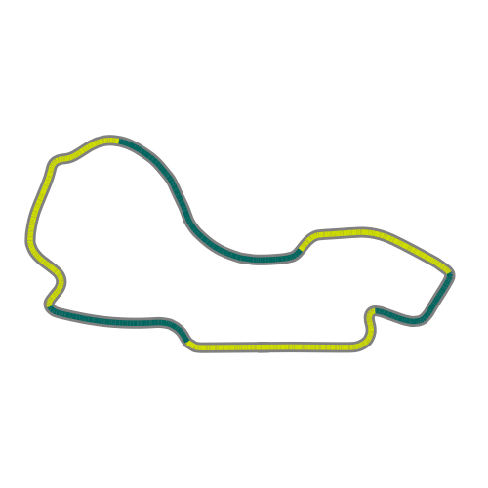
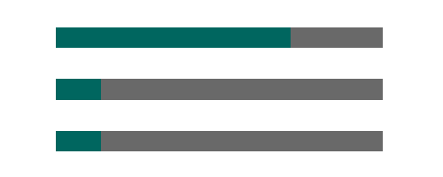
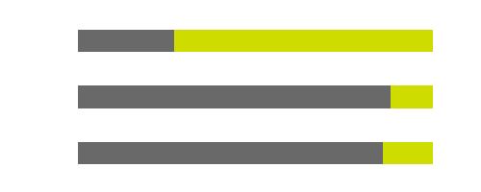
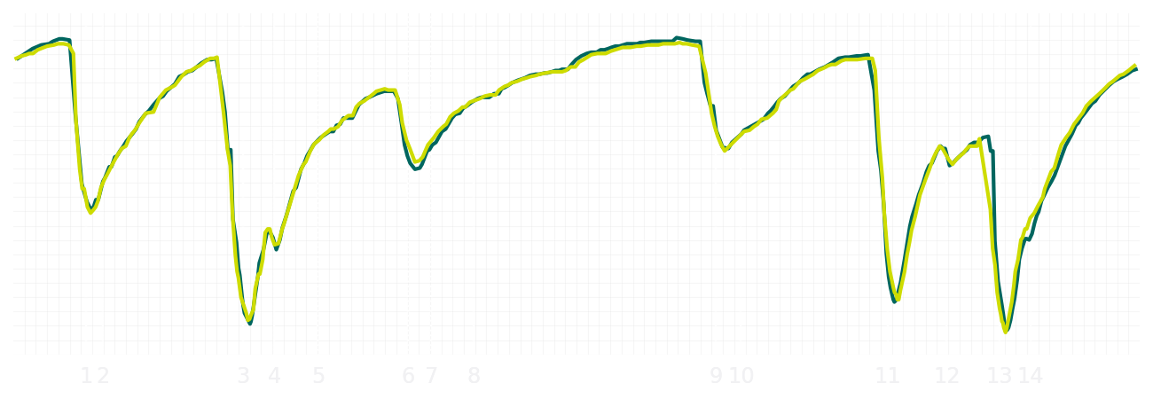
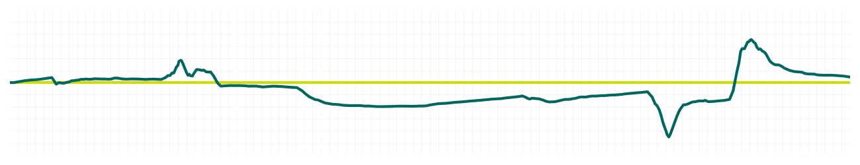
Australian GP Qualifying Q2
Fernando Alonso
Driver
Lance Stroll
Driver
Lap Time
01:16.453
01:16.483
Lap Time
Sector 1
26.374
Speed Trap 1
287 kp/h
Speed Trap 1
288 kp/h
Sector 1
26.457
Sector 2
17.188
Speed Trap 2
328 kp/h
Gap
-0.03
Gap
0.03
Speed Trap 2
325 kp/h
Sector 2
17.173
Sector 3
32.891
Speed Final Line
305 kp/h
Corner Advantage
10/15
Corner Advantage
5/15
Speed Final Line
307 kp/h
Sector 3
32.853
FULL THROTTLE
72%
73%
FULL THROTTLE
HEAVY BREAKING
14%
12%
HEAVY BREAKING
%LAP TIME
CORNERING
14%
15%
CORNERING
%LAP TIME
SPEED
SPEED
DELTA TIME
DELTA TIME

Slide 3

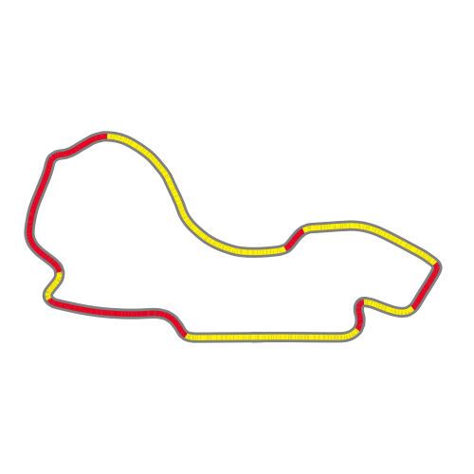
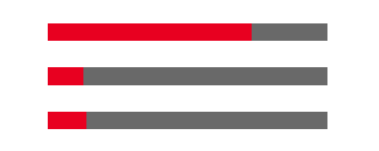
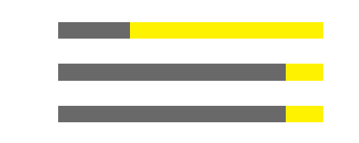
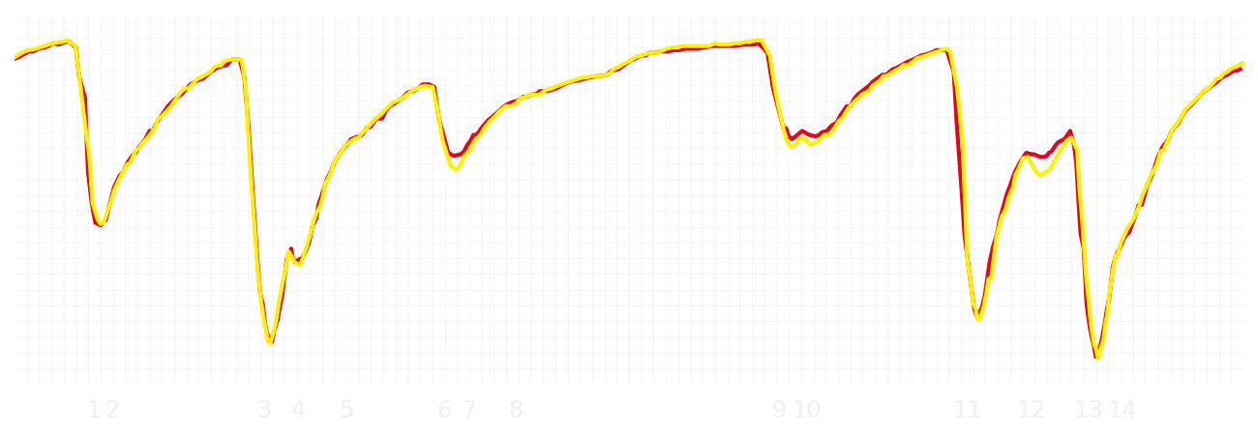
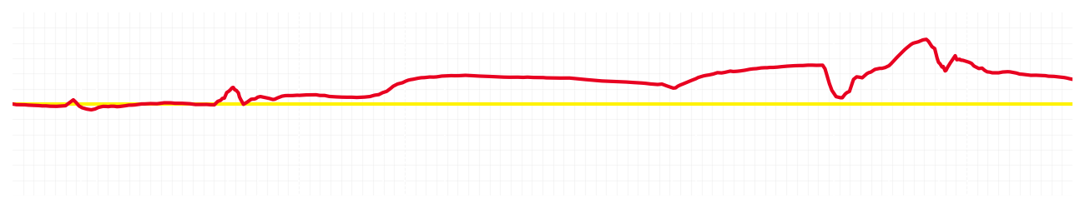
Australian GP Qualifying Q2
Charles Leclerc
Driver
Lewis Hamilton
Driver
Lap Time
01:15.827
01:15.919
Lap Time
Sector 1
26.184
Speed Trap 1
289 kp/h
Speed Trap 1
289 kp/h
Sector 1
26.150
Sector 2
17.155
Speed Trap 2
320 kp/h
Gap
-0.092
Gap
0.092
Speed Trap 2
321 kp/h
Sector 2
17.223
Sector 3
32.488
Speed Final Line
303 kp/h
Corner Advantage
6/15
Corner Advantage
9/15
Speed Final Line
306 kp/h
Sector 3
32.546
FULL THROTTLE
73%
73%
FULL THROTTLE
HEAVY BREAKING
13%
14%
HEAVY BREAKING
%LAP TIME
CORNERING
14%
13%
CORNERING
%LAP TIME
SPEED
SPEED
DELTA TIME
DELTA TIME

Slide 4

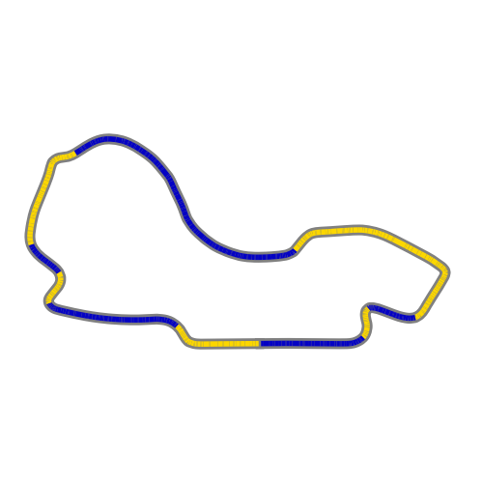

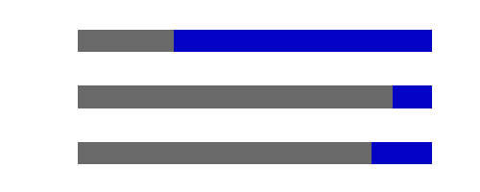
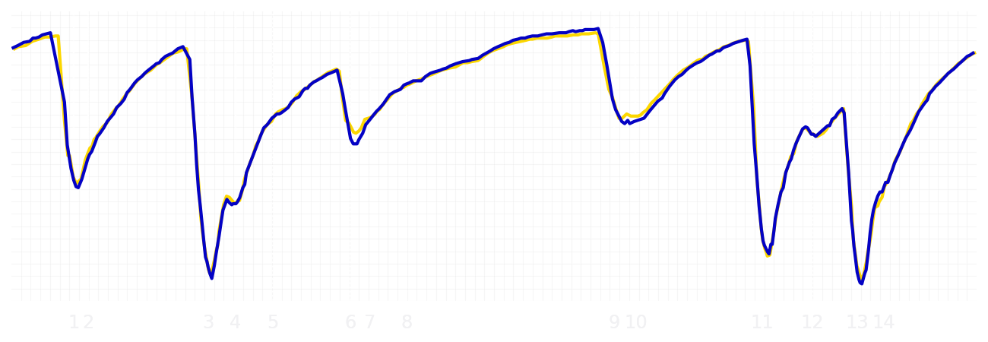
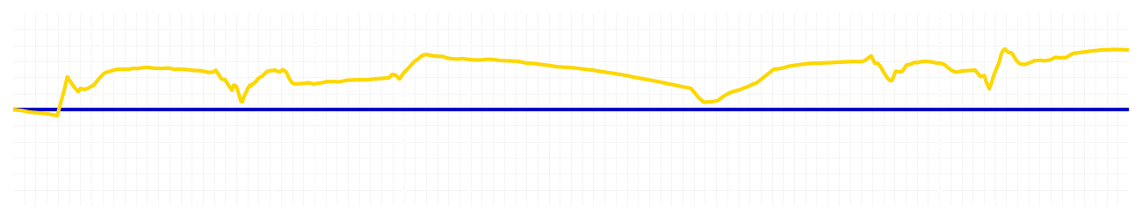
Australian GP Qualifying Q2
Yuki Tsunoda
Driver
Isack Hadjar
Driver
Lap Time
01:16.009
01:16.175
Lap Time
Sector 1
26.264
Speed Trap 1
289 kp/h
Speed Trap 1
289 kp/h
Sector 1
26.345
Sector 2
17.193
Speed Trap 2
325 kp/h
Gap
-0.166
Gap
0.166
Speed Trap 2
328 kp/h
Sector 2
17.148
Sector 3
32.552
Speed Final Line
307 kp/h
Corner Advantage
5/15
Corner Advantage
10/15
Speed Final Line
309 kp/h
Sector 3
32.682
FULL THROTTLE
73%
73%
FULL THROTTLE
HEAVY BREAKING
10%
11%
HEAVY BREAKING
%LAP TIME
CORNERING
17%
16%
CORNERING
%LAP TIME
SPEED
SPEED
DELTA TIME
DELTA TIME

Slide 5

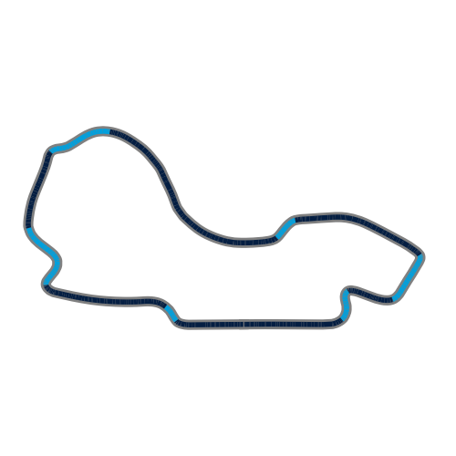
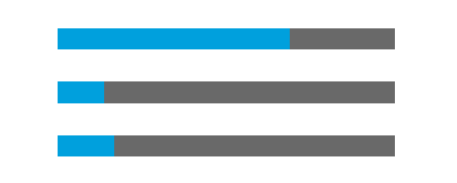

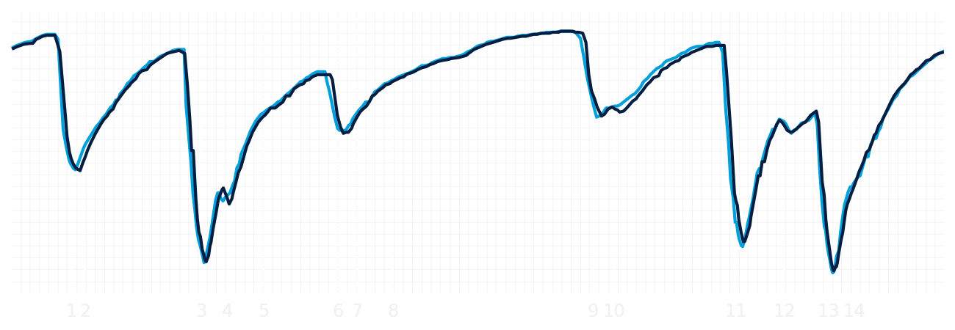
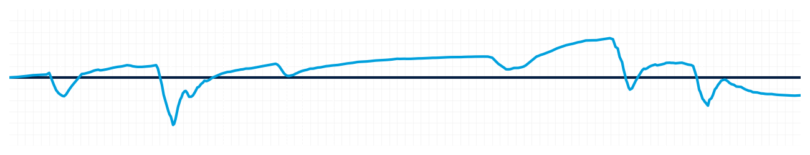
Australian GP Qualifying Q2
Alexander Albon
Driver
Carlos Sainz
Driver
Lap Time
01:16.017
01:15.931
Lap Time
Sector 1
26.186
Speed Trap 1
289 kp/h
Speed Trap 1
287 kp/h
Sector 1
26.269
Sector 2
17.034
Speed Trap 2
328 kp/h
Gap
0.086
Gap
-0.086
Speed Trap 2
328 kp/h
Sector 2
17.078
Sector 3
32.797
Speed Final Line
309 kp/h
Corner Advantage
7/15
Corner Advantage
8/15
Speed Final Line
308 kp/h
Sector 3
32.584
FULL THROTTLE
69%
70%
FULL THROTTLE
HEAVY BREAKING
14%
16%
HEAVY BREAKING
%LAP TIME
CORNERING
17%
14%
CORNERING
%LAP TIME
SPEED
SPEED
DELTA TIME
DELTA TIME

Slide 6

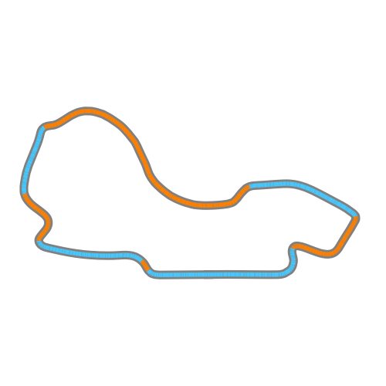

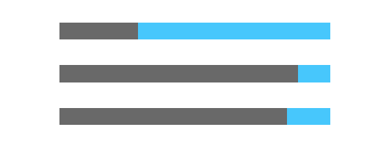
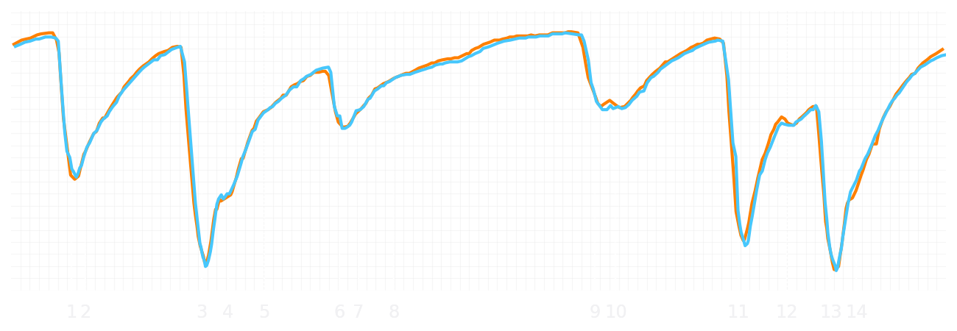
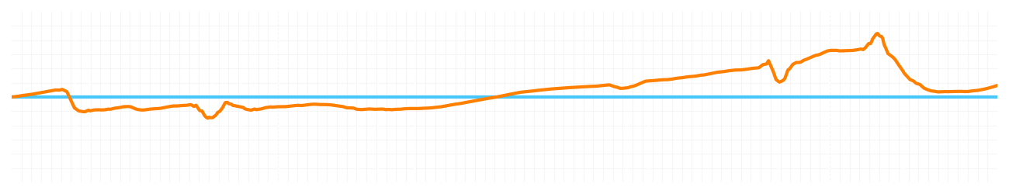
Australian GP Qualifying Q2
Lando Norris
Driver
Oscar Piastri
Driver
Lap Time
01:15.415
01:15.468
Lap Time
Sector 1
26.194
Speed Trap 1
289 kp/h
Speed Trap 1
290 kp/h
Sector 1
26.171
Sector 2
17.030
Speed Trap 2
325 kp/h
Gap
-0.053
Gap
0.053
Speed Trap 2
324 kp/h
Sector 2
17.111
Sector 3
32.191
Speed Final Line
310 kp/h
Corner Advantage
6/15
Corner Advantage
9/15
Speed Final Line
305 kp/h
Sector 3
32.186
FULL THROTTLE
72%
71%
FULL THROTTLE
HEAVY BREAKING
12%
12%
HEAVY BREAKING
%LAP TIME
CORNERING
16%
17%
CORNERING
%LAP TIME
SPEED
SPEED
DELTA TIME
DELTA TIME

